Slide 1
Ferrous Alloys
Pablo Sebastián Castán arellano 1816043
Martes m4-m6 Group: 013

Slide 2
Ferrous Alloys
Steel.
Classification of Steel.
Cast Irons
Advantages and disadvantages of Ferrous Alloys.
AISI code.
What is a microstructure?

Slide 3
Metal alloys
Ferrous
Non ferrous
Cast irons
Steel

Slide 4
Steel
Low alloy
Medium carbon
High Carbon
High alloy
Stainless
Low carbon
Plain
High Strength Low alloy
Plain
Heat treatable

Slide 5
Cast Irons
Gray Iron
Ductile iron
White and Malleable iron
Compacted graphite iron

Slide 6
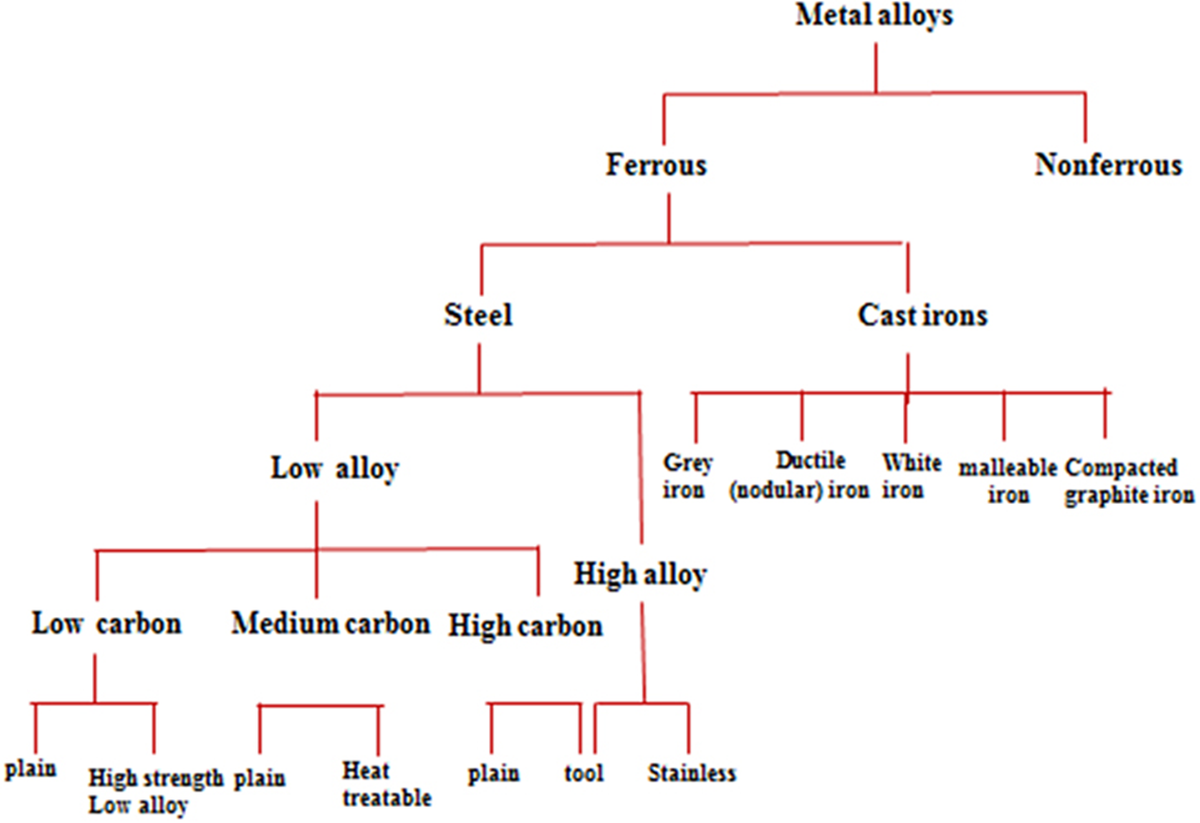

Slide 7
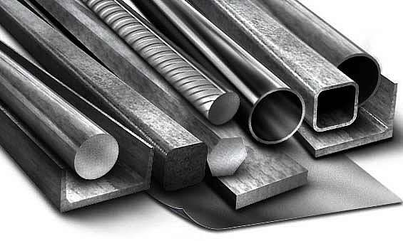

Steels
Steels are iron–carbon alloys that may contain appreciable concentrations of other alloying elements
There are thousands of alloys that have different compositions and/or heat treatments.
Some of the more common steels are classified according to carbon concentration and high carbon types.
Used in the construction and manufacturing industries.

Slide 8
Low carbon Steels
Plain carbon steels- very low content oof alloying elements and small amounts on Mn.
Most abundant grade of steel is low carbon steel – greatest quantity produced, least expensive.
Not responsive to heat treatment
Good weldability and machinability
High strength Low alloy (HSLA) steels – alloying elements up to 10wt%
Higher strengths

Slide 9
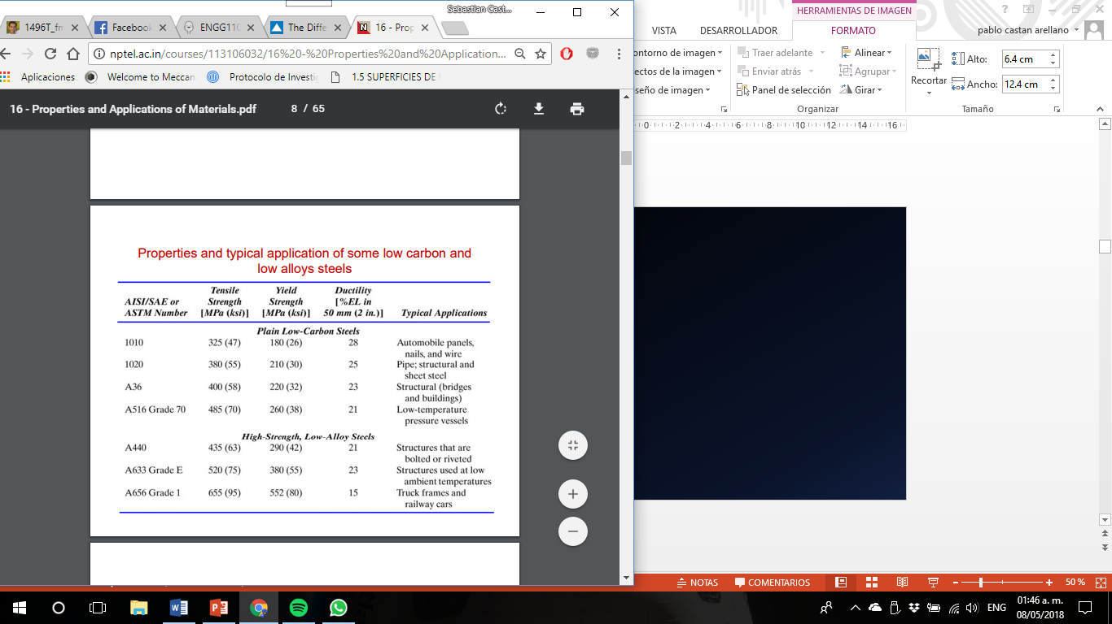
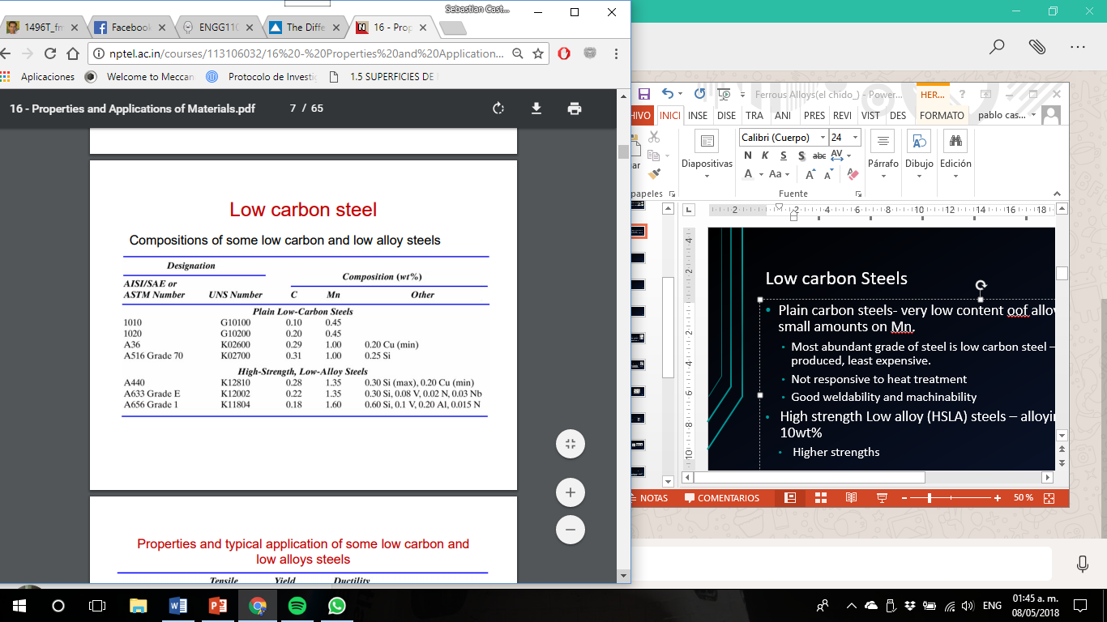

Slide 10
Medium carbon
Carbon content in the range of 0.3 – 0.6%
Can be heat treated – austenitizing, quenching and then tempering.
Have low hardenability.
Addition of Cr, Ni, Mo improves the eat treating capacity
Stronger but lower ductility.
Typical applications-Railway wheels and tracks, gears, cranksafts

Slide 11
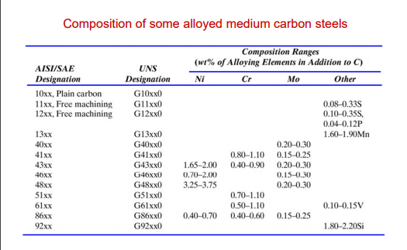

Slide 12
High carbon
Carbon content 0.6 – 1.4 %
High Carbon content provides high hardness and strenght
Hardest and least ductile.
Used as tool and die steels owing to the high hardnes and wear resistance property.

Slide 13
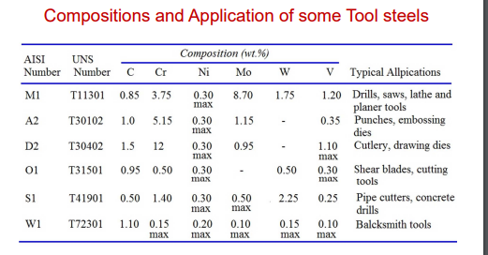

Slide 14
Stainless Steel
A group of steels that contain at least 11% Cr.
Categories of stainless steels
Ferritic- Composed of ferrite BCC
Martensitic – can be heat treated
Austenite – Austenite phase field is extended to room temperature. Most corrosion resistant.
Precipitation Hardening- Ultra high- strenght due to precipitation hardening.
Duplex- Ferrite + Austenite

Slide 15
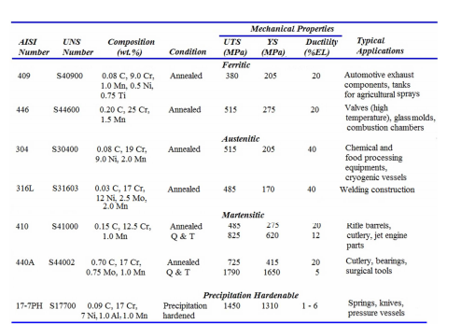

Slide 17
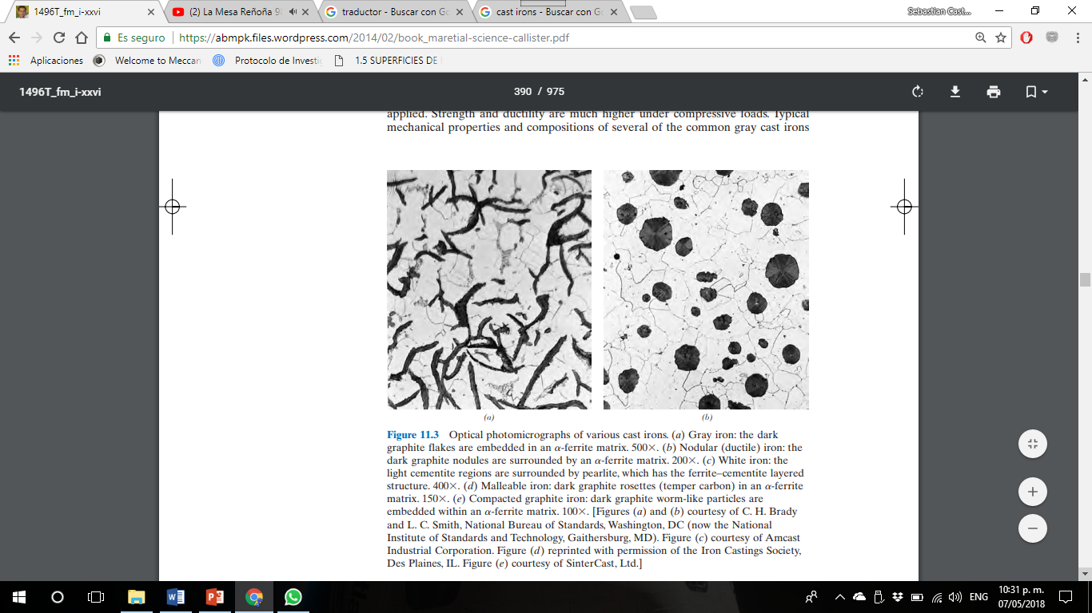
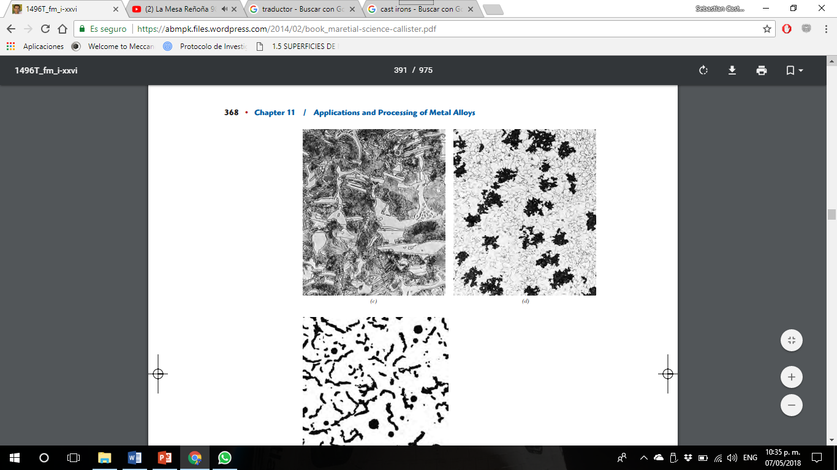
Cast Irons
Cast irons are a class of ferrous alloys with carbon contents above 2.14 wt%
For most cast irons, the carbon exists as graphite, and both microstructure and mechanical behavior depend on composition and heat treatment.
The most common cast iron types are gray, nodular, white, malleable, and compacted graphite.
Gray Iron Ductile Iron
White Iron Malleable Iron

Slide 18
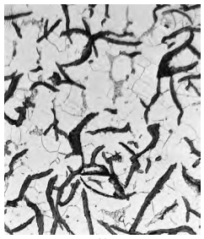

Gray Irons
The least expensive and most common type.
Typical composition ranges from 2.5-4.0% C, 1-3% Si and 0.4-1.0% Mn.
Contains small interconnected graphite flakes that cause low strength and ductility.
It is the most widely used cast iron.
It is named for the dull gray color of te fractured surface.
The dark graphite flakes are embedded in an -ferrite matrix.

Slide 19
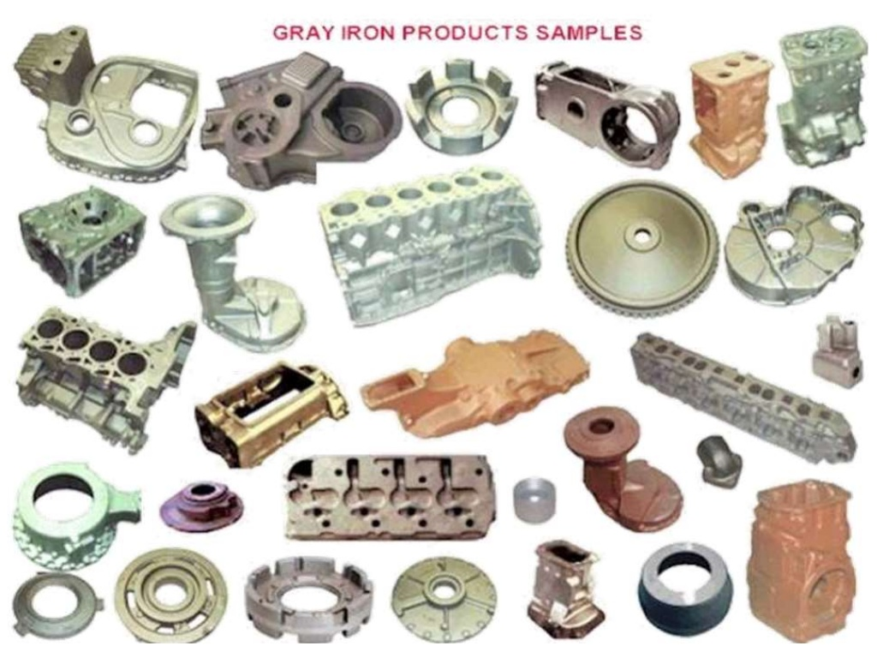

Slide 20
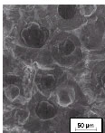
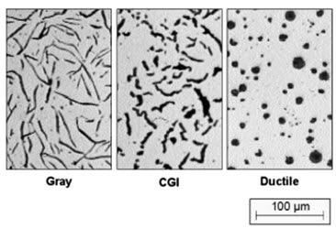
Ductile Iron
Far better ductility tan grey cast iron
It has mechanical characteristics approaching those of Steel.
Typical applications for tis materials include
Valves
Pump bodies
Crankshafts
Gears
Machine components

Slide 21
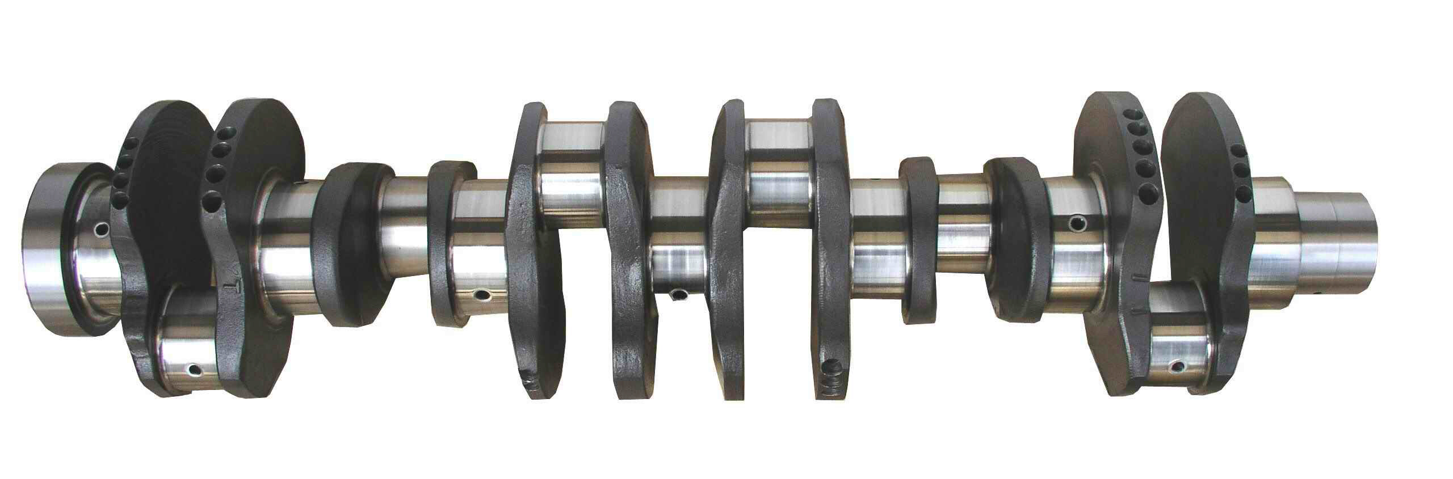
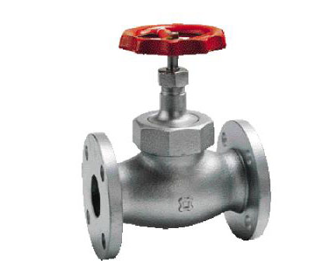

Slide 22
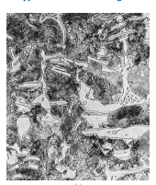
White cast iron
Contains massive amounts of Fe3C.
A fractured Surface of tis materials appears white, hence the name.
1.8 - 3.6%C 0.5 – 1.9%Si 0.25-0.%Mn
A Group of highly alloyed white irons are used for their hardness and resistance to abrasive wear.
Its use is limited to applications that necessitate a very hard and wear-resistant surface, without a high degree of ductility.
Produced in smaller quantities.

Slide 23
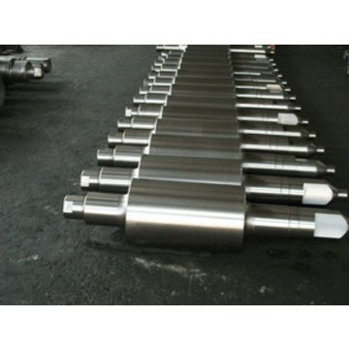

Slide 24
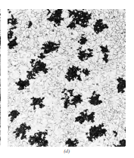
Malleable Cast Iron
Formed by the heat treatment of unalloyed 3%C white cast iron.
It exhibits better ductility tan gray or White cast irons. It is also very machinable.
Produced in smaller quantities.
Representative applications include
Connecting rods
Transmision gears
Automotive industry
In heavy duty services.

Slide 25
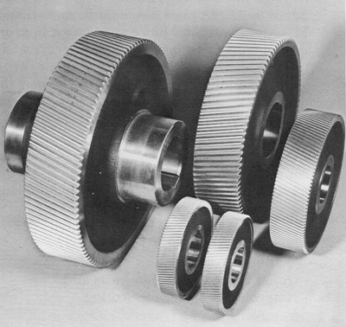
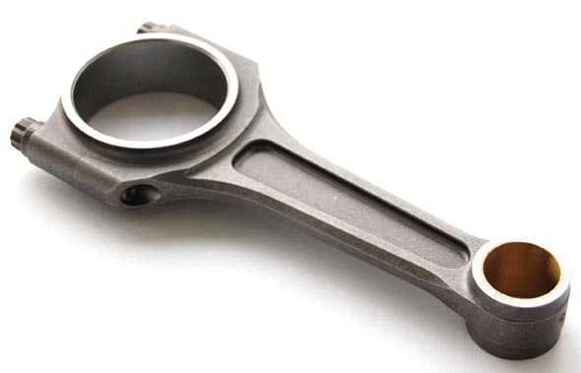

Slide 26
Compacted graphite iron
Contains rounded but interconnected grapite also produced during solidification
Intermediate between flake and spheres with numerous rounded rods of graphite that are interconnected to th nucleus of the eutectic cell
Microstructurally, the graphite in CGI alloys has a worm-like (or vermicular) shape.
The chemistries of CGIs are more complex than for the other cast iron types.
Are used for
Diesel engine blocks
Exhaust manifolds
Gearbox housings
Brake discs for hig speed trains
Flywheels

Slide 27
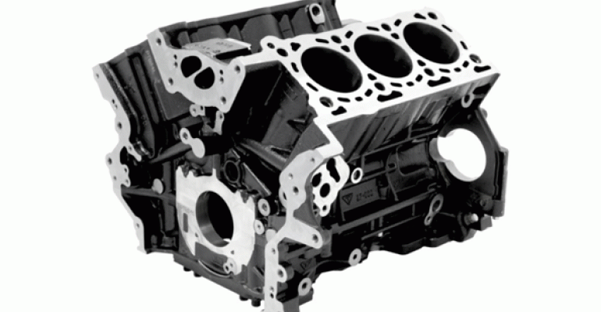
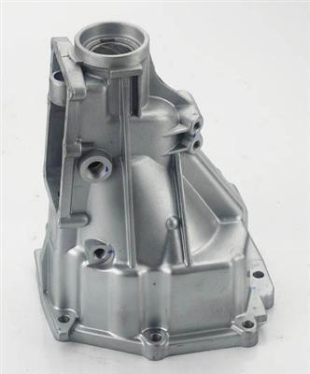
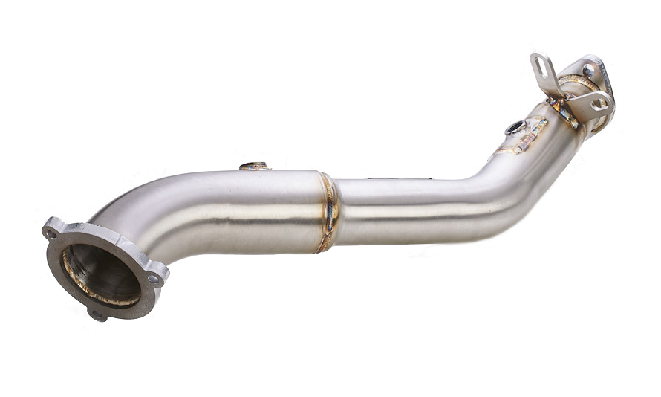

Slide 28
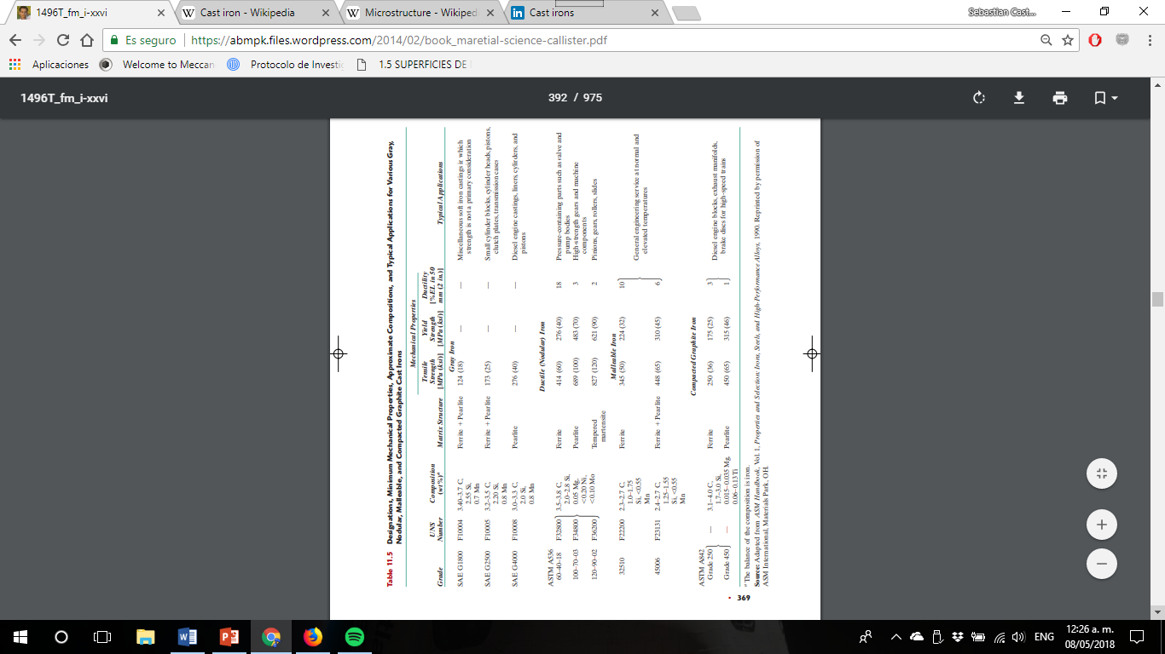

Slide 29
Advantages and disadvantages of Ferrous Alloys
Advantages
Disadvantages
They can be cheap
They display an endurance limit when loaded in fatigue, making them practical for applications requiring 100s of millions or billions of cycles
Some alloys can be case hardened via nitriding or carburizing processes, effectively producing a composite structure with a tough, ductile core and a hard, wear-resistant case.
They can be incredibly strong
They can have very high fracture toughness
The have relatively high temperature capability
The principal disadvantage of many ferrous alloys is their susceptibility to corrosion.
Requires more energy to form.

Slide 30
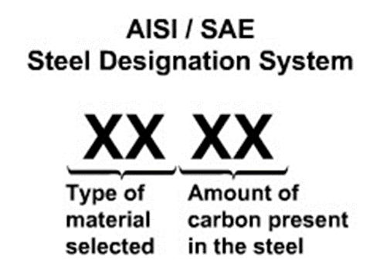
AISI code
The AISI/SAE designation for these steels is a four-digit number:
The first two digits indicate the alloy content;
the last two give the carbon concentration. For plain carbon steels, the first two digits are 1 and 0; alloy steels are designated by other initial two-digit combinations (e.g., 13, 41, 43).
The third and fourth digits represent the weight percent carbon multiplied by 100.
For example, a 1060 steel is a plain carbon steel containing 0.60 wt% C

Slide 31
What is a microstructure?

Slide 32
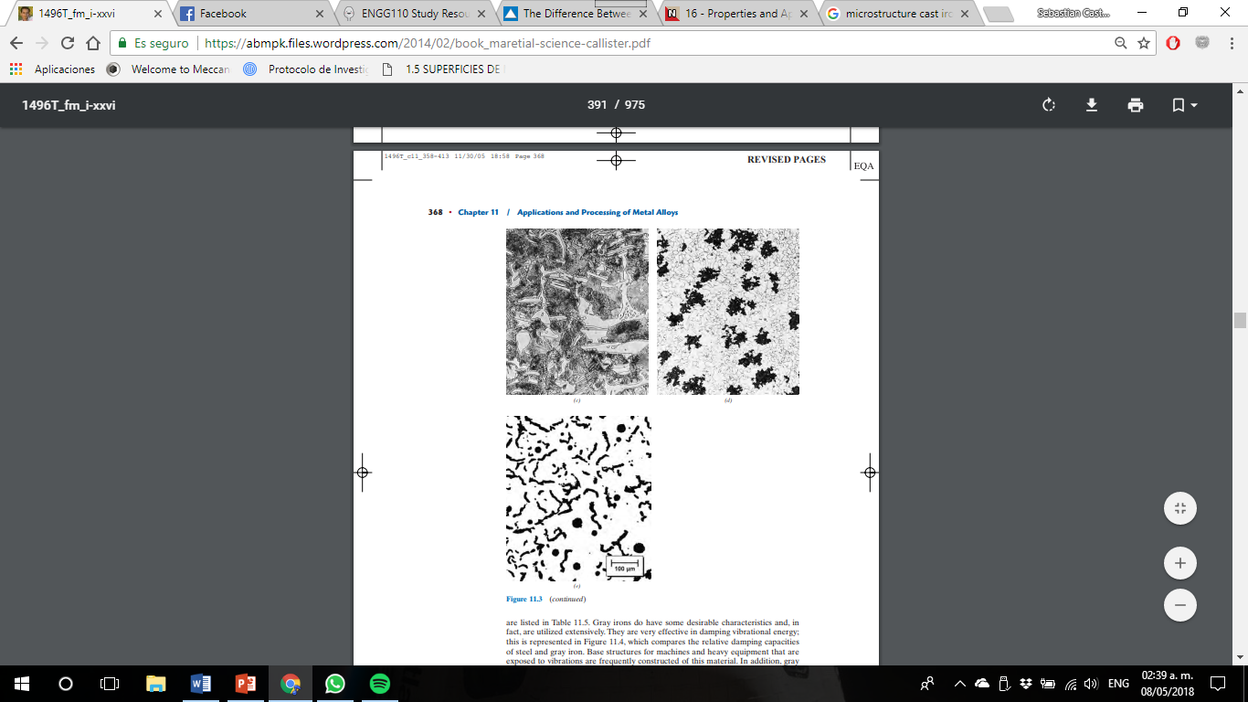
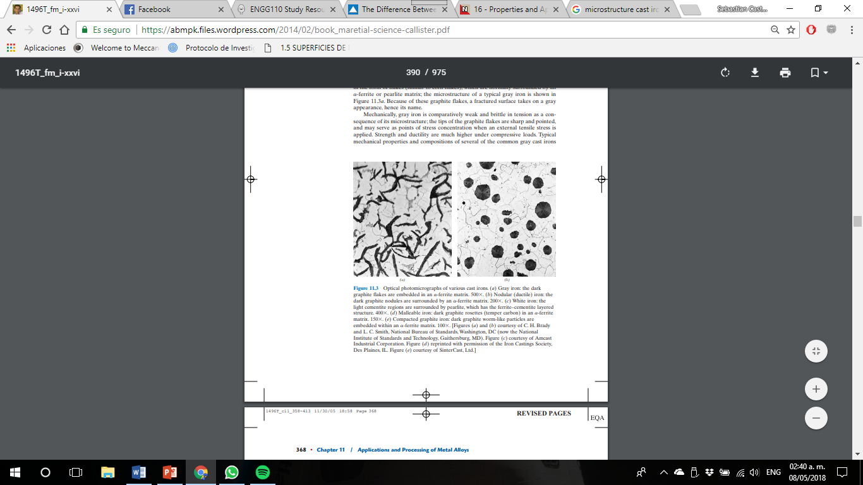

Slide 33
References
William D. Callister, Materials Science and engineering an introduction, 7th Edition; Utah, USA. 2007
https://www.metalsupermarkets.com/the-difference-between-ferrous-and-non-ferrous-metal/
http://nptel.ac.in/courses/113106032/16%20-%20Properties%20and%20Applications%20of%20Materials.pdf

